Slide 1
Where do these spectral lines come from?

Slide 2
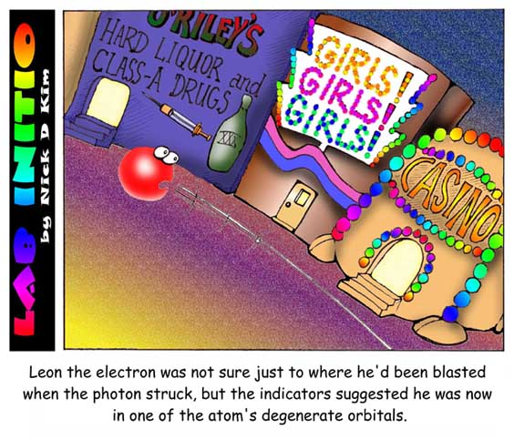

Slide 3
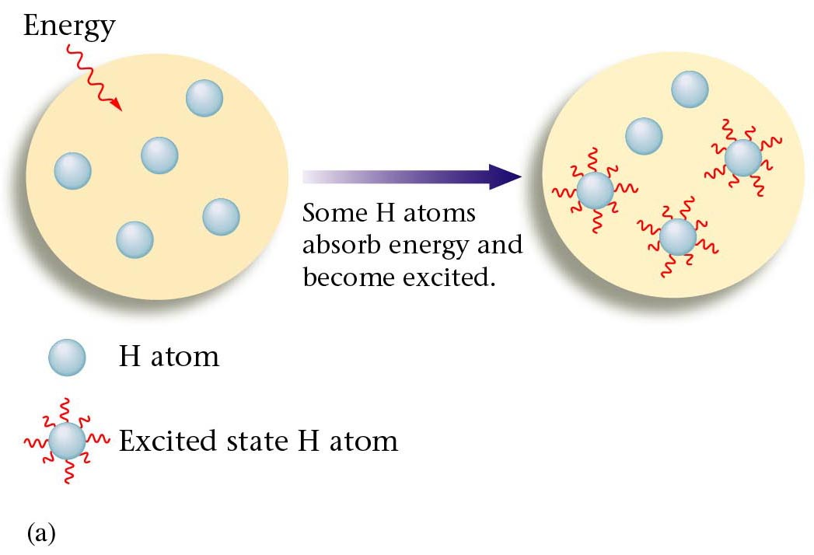
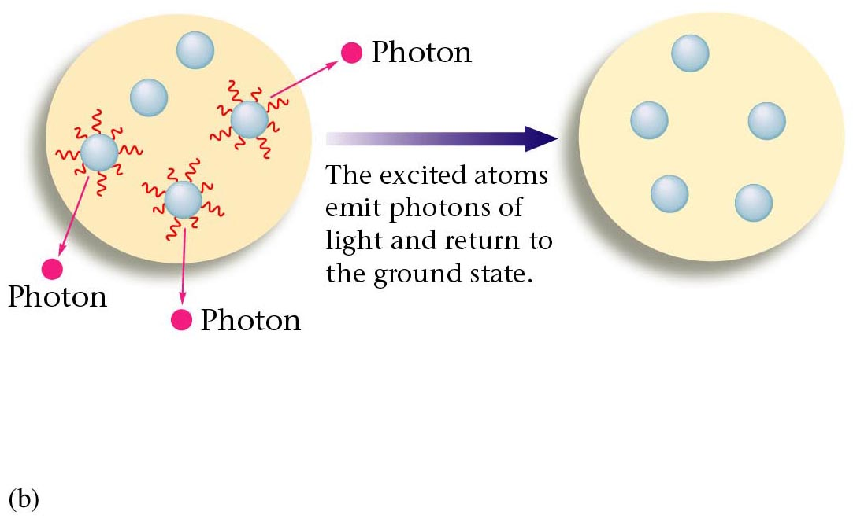
A sample of H atoms receives energy from an external source.
Excited state H atom = e has absorbed energy (photon of light
Ie the electron has ‘shifted up’ to a high energy shell / level
A photon is released as the electron ‘shifts down’ to a lower – more stable energy shell / level

Slide 4
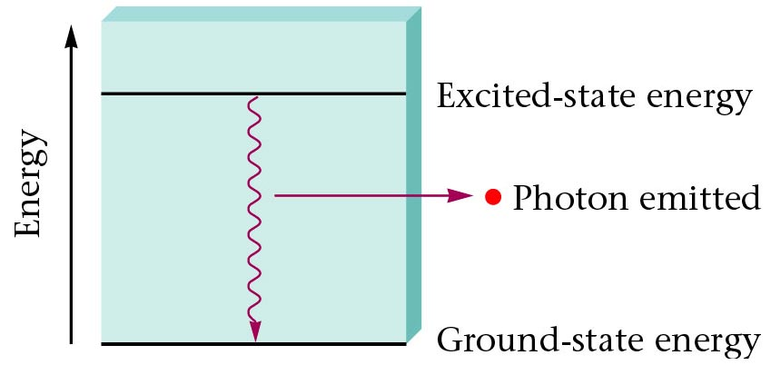
An excited H atoms electron returns to a lower energy level.

Slide 5
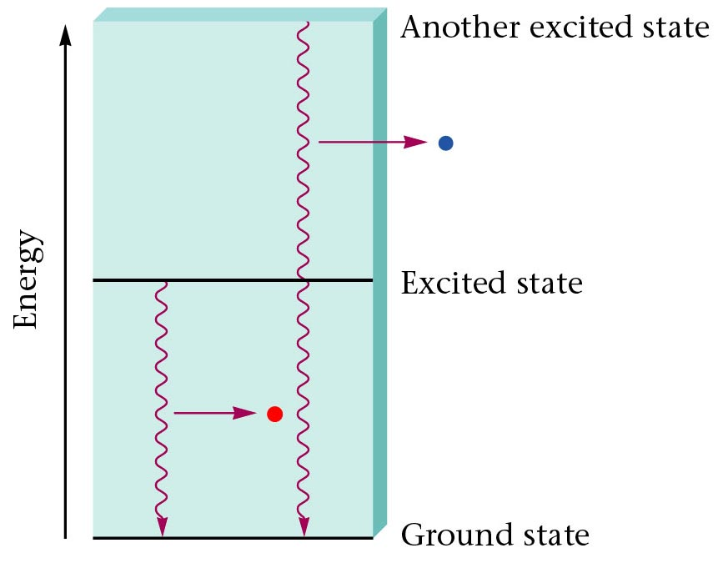
The colour of the photon emitted depends on the energy change that produces it.

Slide 6
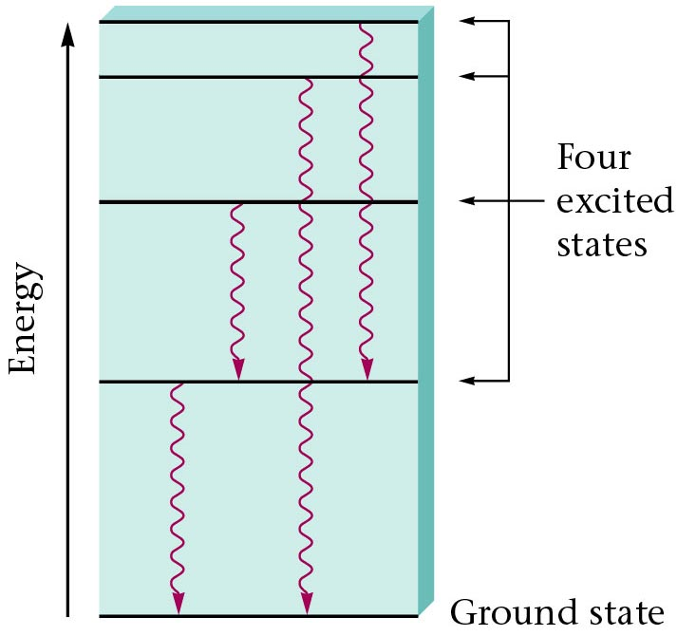
Each photon emitted corresponds to a particular energy change.

Slide 7
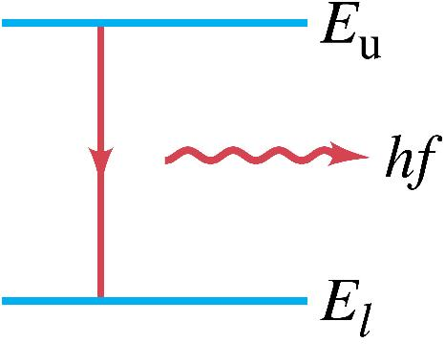
Bohr proposed that the possible energy states for atomic electrons were quantized – only certain values were possible. Then the spectrum could be explained as transitions from one level to another.

Slide 8
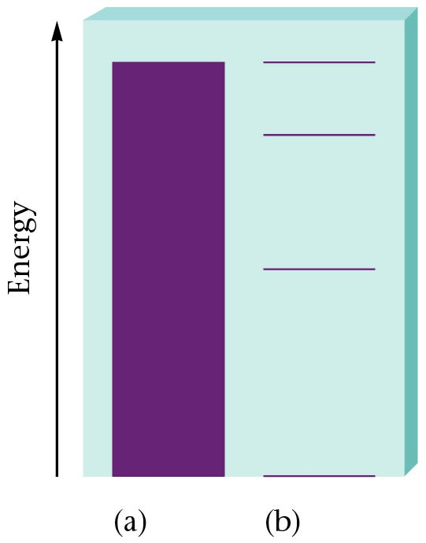
Continuous or discrete energy levels?
The difference between continuous and quantized energy levels.

Slide 9
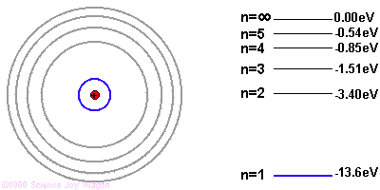

Slide 10
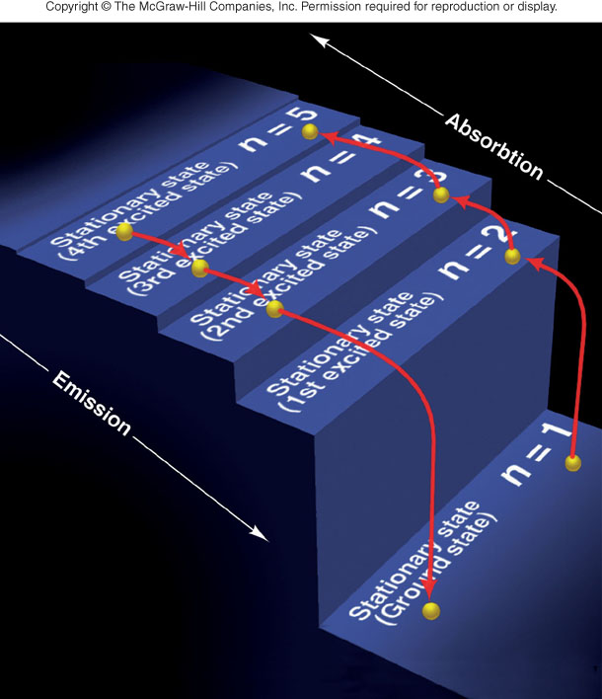
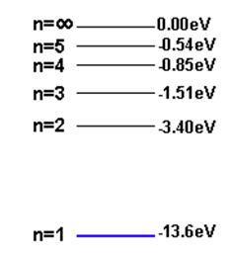
Quantum staircase

Slide 11
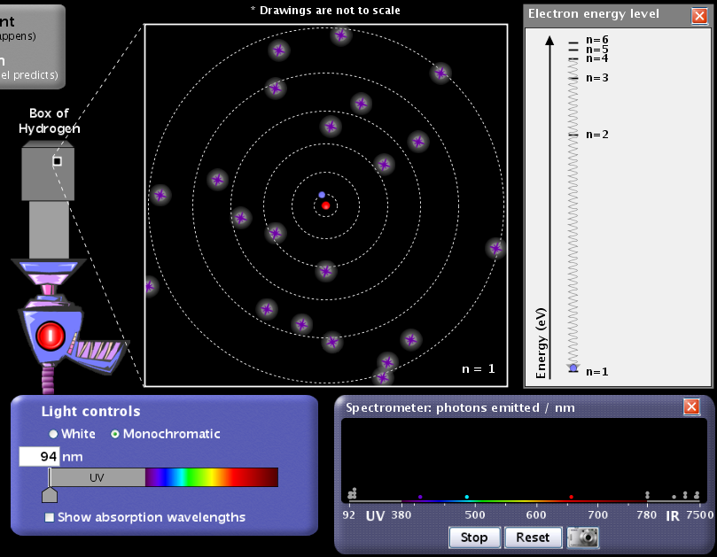
See PhET applet

Slide 12
Summary Quantized Energy Levels (n)
Electrons in free atoms are ‘Quantized’ ~ they reside only in discrete energy levels. Discrete energy levels are also termed ‘orbits,’ states’ or ‘shells level’.
Only photon of exact energies are absorbed or emitted when electrons jump between higher and lower levels.
All energy values are defined as negative; this represents the energy which binds the electron to the nucleus and needs to be supplied for the electron to move up a level.
The lowest energy level (n=1) is called the ground state.
As n→∞, E→0. For Hydrogen, 13.6 eV is its Ionisation energy ~ the energy required to ionise the atom or strip its electron away.
Three basic ways to excite an electron in an atom (get to move to higher energy level):
Collide it with another atom or electron.
Heat it up (thermal excitation)
Bombard it with a photon of just the right energy (colour).
Notes:
The electrons in free atoms can will be found in only certain discrete energy states. These sharp energy states are associated with the orbits or shells of electrons in an atom, e.g., a hydrogen atom. One of the implications of these quantized energy states is that only certain photon energies are allowed when electrons jump down from higher levels to lower levels, producing the hydrogen spectrum. The Bohr model successfully predicted the energies for the hydrogen atom, but had significant failures that were corrected by solving the Schrodinger equation for the hydrogen atom.

Slide 13
Find the ΔE between energy levels that gives the visible emission spectrum for Hydrogen ie red photons of 656 nm

Slide 14
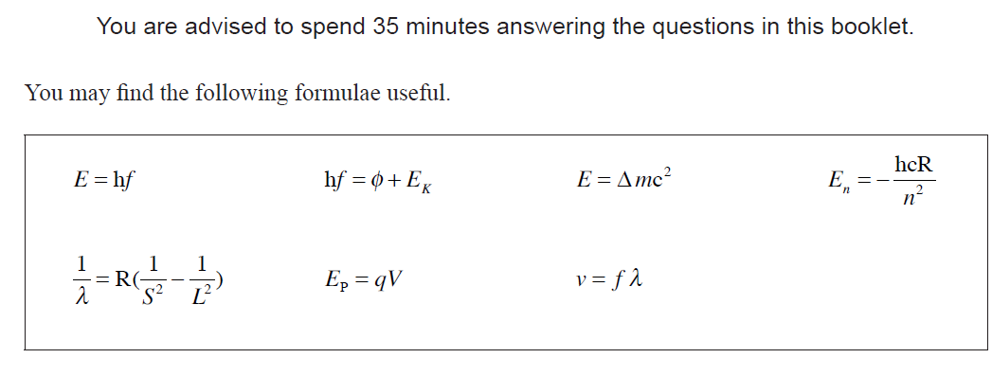
Balmer
Bohr

Slide 15
Balmer
Bohr
Why negative?

Slide 16
Hydrogen Atom - absorption
n = ∞
0 eV
E
r₄
n = 5
−0.54 eV
n = 4
−0.85 eV
r₃
n = 3
−1.5 eV
r₂
n = 2
−3.4 eV
r₁
Ground
state
n = 1
−13.6 eV
E₁ = 10.2 eV
E₂ = 12.1 eV
E₃ = 12.75 eV

Slide 17
Hydrogen Atom – visible emission
n = ∞
0 eV
E
r₄
n = 5
−0.54 eV
n = 4
−0.85 eV
r₃
n = 3
−1.5 eV
r₂
n = 2
−3.4 eV
r₁
Ground
state
n = 1
−13.6 eV
656
486
434
410

Slide 18
Balmer
Bohr

Slide 19
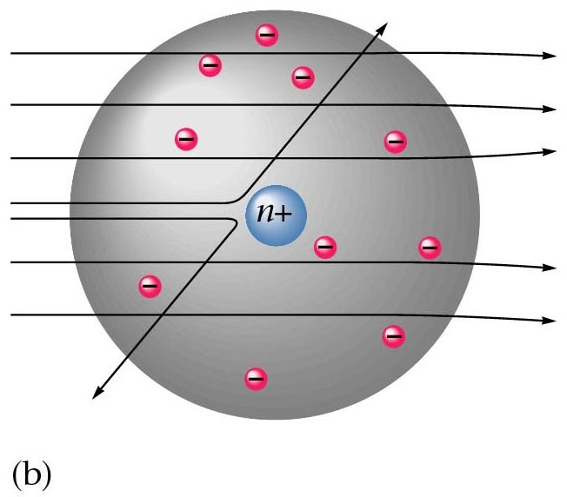
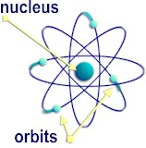
Rutherford’s Model
Gold foil / leaf experiment
Discovered dense positive piece of mass at the center of the atom called the nucleus
Nucleus contains positive protons
Mostly empty space
Negatively charged electrons orbiting the
nucleus ~ Planet model

Slide 20
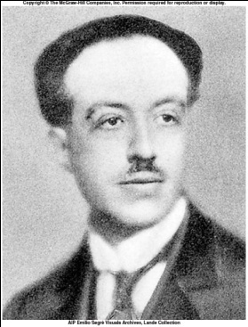
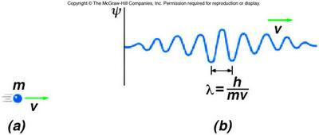
De Broglie Waves
In 1924, the French physicist Louis de Broglie proposed that moving objects behave like waves; these are called matter waves.
The de Broglie wavelength of a particle of mass m and speed v is λ = ^{h}/_{mv}.

Slide 21
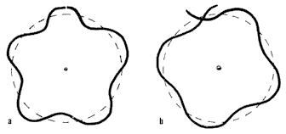
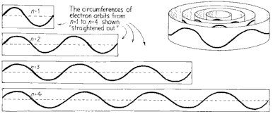
An 18-wheeler moving at 100 km/h has a wavelength smaller than an atom.
However, an electron (very light) moves much faster and its wavelength is much larger than its size.

Slide 22
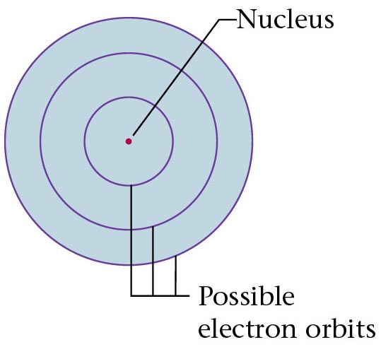
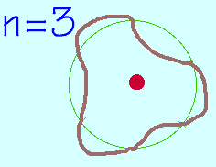
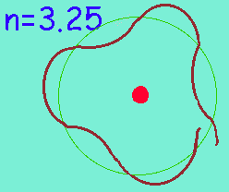
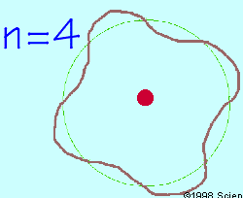
The Rutherford Model of the atom created its own set of problems:
Why didn’t the electron radiate away its own energy and fall into the nucleus?
Why did atoms emit only discrete wavelengths of light?
The Bohr & de Broglie Models answered these questions.
Bohr built upon spectroscopic observations of atoms (Balmer) and that electrons have angular momentum properties.
de Broglie recognised that electrons are in a sense waves as well as particles (wave – particle duality).
They form standing waves around a certain
orbit, like harmonics on resonating strings!
Only a whole number (n) of wavelengths will fit on a circumference. n is the quantized
energy level number.
Notes:
Quantized Energy States
The electrons in free atoms can will be found in only certain discrete energy states. These sharp energy states are associated with the orbits or shells of electrons in an atom, e.g., a hydrogen atom. One of the implications of these quantized energy states is that only certain photon energies are allowed when electrons jump down from higher levels to lower levels, producing the hydrogen spectrum. The Bohr model successfully predicted the energies for the hydrogen atom, but had significant failures that were corrected by solving the Schrodinger equation for the hydrogen atom.

Slide 23
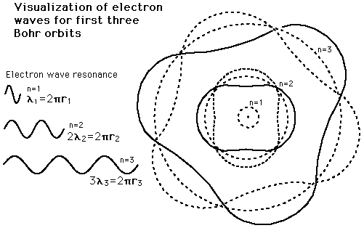

Slide 24
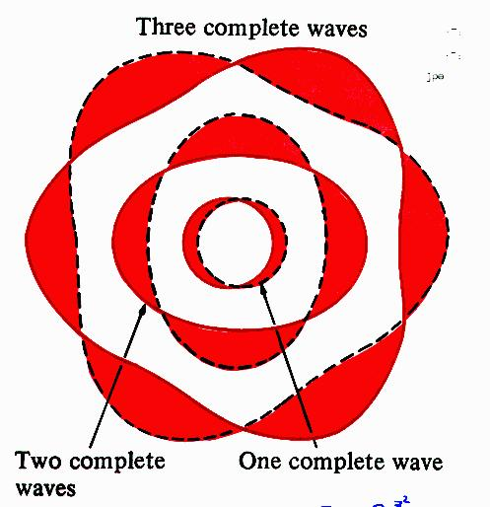

Slide 25
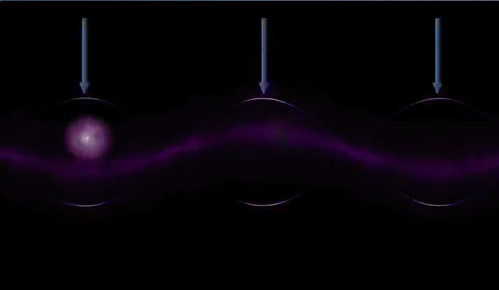
Video: Is the Electron a Wave or a Particle

Slide 26
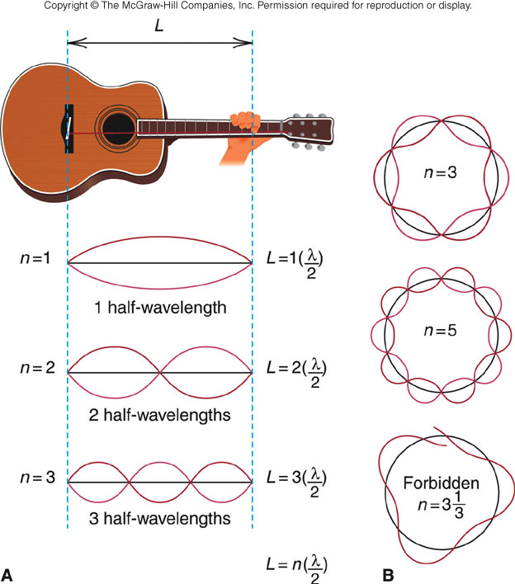

Slide 27
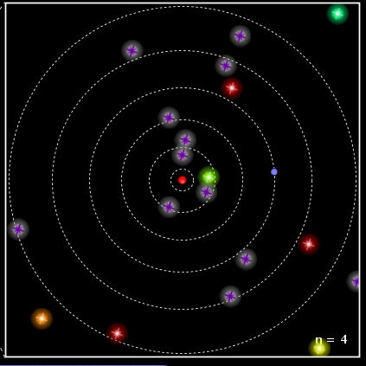

Slide 28
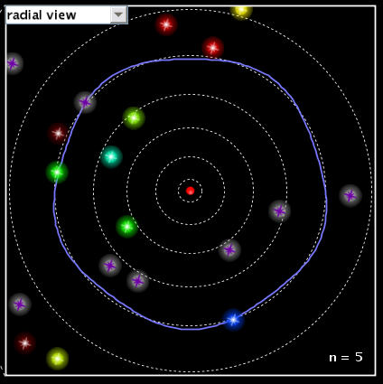

Slide 29
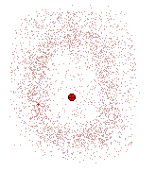
Quantum Theory (dealing with small particles)
Builds on Bohr idea, atom is described using mathematical equations and the position of an electron is described in terms of its probability of being in a particular position.
Schrodinger
Derived a set of equations or wave functions for electrons. According to Schrodinger, electrons confined in their orbits would set up standing waves and you could describe only the probability of where an electron could be. The distributions of these probabilities formed regions of space about the nucleus were called orbitals. Orbitals could be described as electron density clouds
Modern Model of the Atom ~ The electron cloud
Spherical cloud of varying density which shows
where an electron is more or less likely to be
Subatomic particles (smaller them an atom) have been suggested and discovered (not in Level 3 NCEA Physics...)

Slide 30
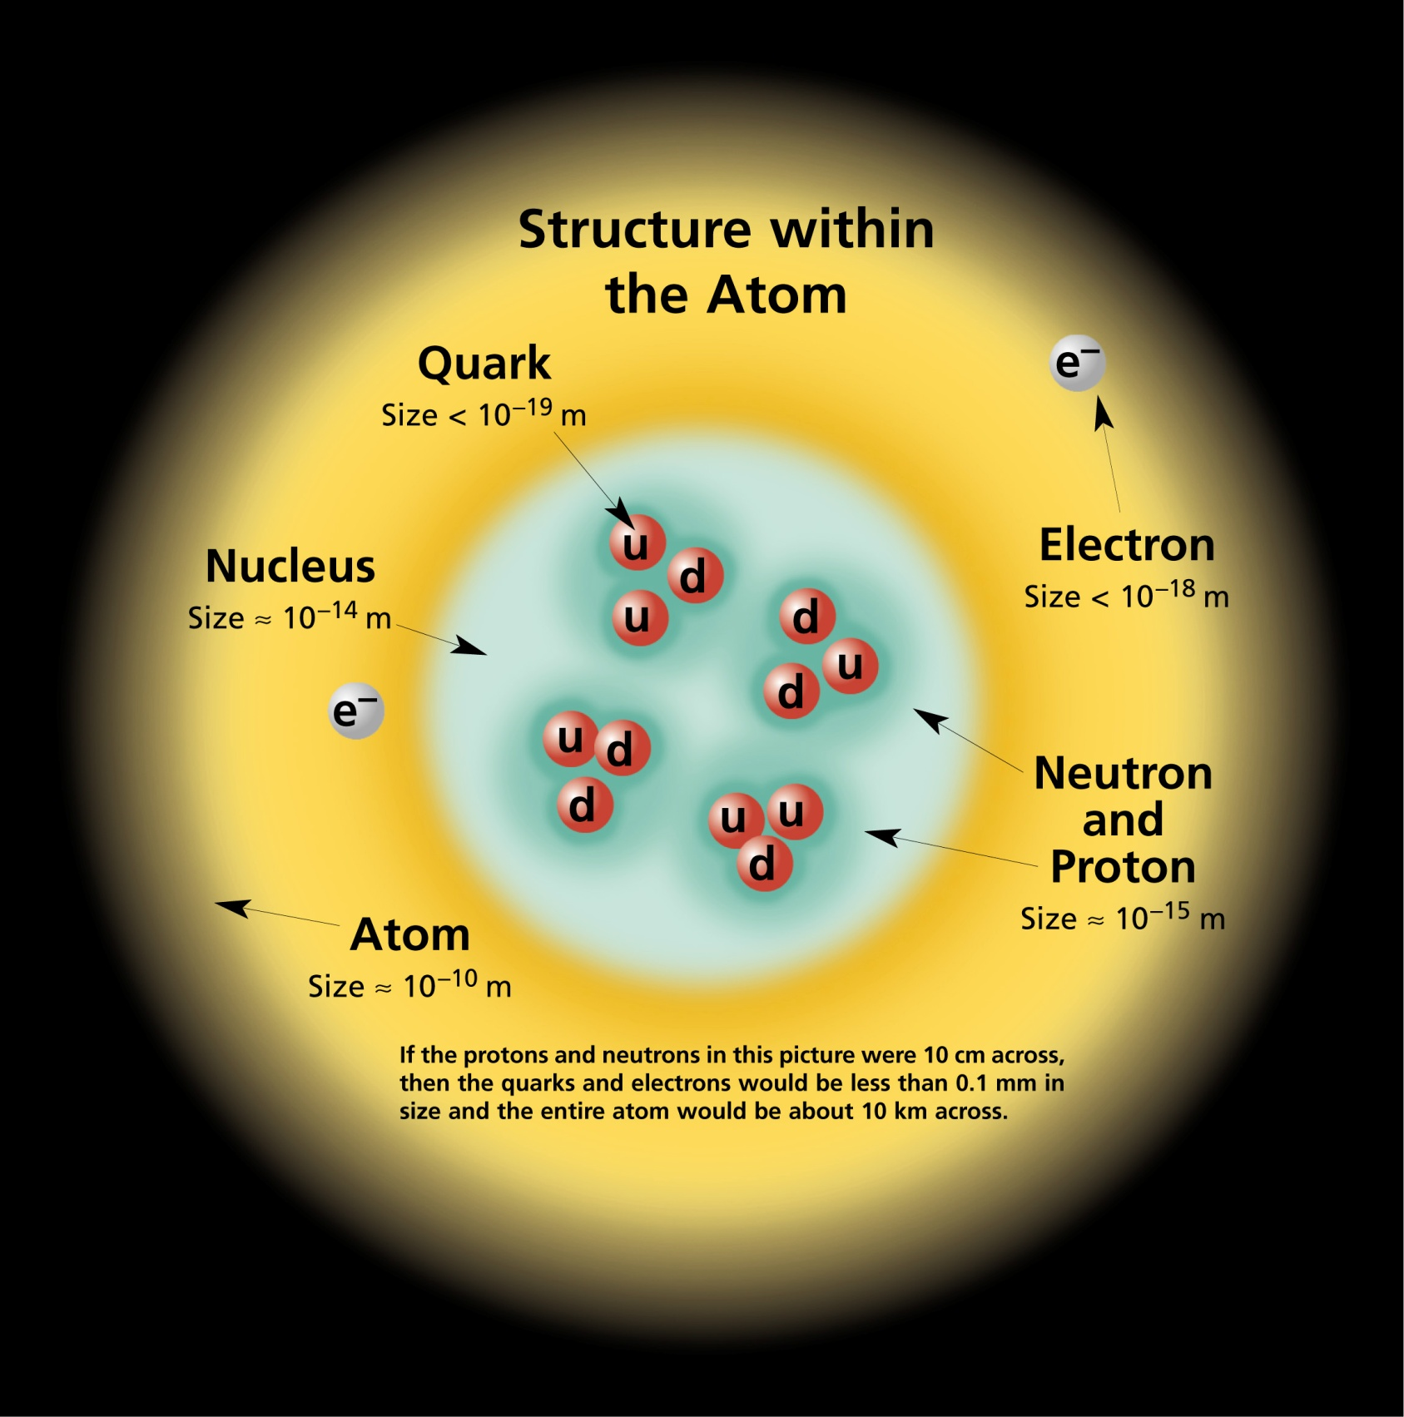

Slide 31
Quantum Evolution: A Brief Timeline.
Bohrs Model (1913) evolved from:
Planck’s Quantum Hypothesis (1900), Einstein’s Photoelectric Effect (1905).
Later developments that improved understanding of Quantum Mechanics were:
De Broglie’s Hypothesis (1923).
Paulli’s Exclusion Principle (1925)
Schrodingers Wave Equation (1926).
Heisenberg’s Uncertainty Principle (1927).
Notes:
Electron Waves and Orbits
Asking why electrons can exist only in some states and not in others is similar to asking how your guitar string knows what pitch to produce when you pluck it. It is a standing wave phenomenon and has to do with resonance

Slide 32
Extra notes…

Slide 33
The Origin of Light
The diagrams to the right show a Hydrogen atom that begins in the energy state of n=3 (n is used to count the energy levels.) Notice that at n=3 there are 3 complete waves in that loop that is the electron.
Creating more waves in the same length of a spring requires more energy. If more energy was added, it may or may not move the electron to the higher energy level. If it is only enough energy to take it to n=3.25, the wave will stay at the n=3 level. This is because the end of the wave and the beginning of the wave must be able to connect in phase. At n=3.25, one end of the wave is on its way up, the other on its way down. Physically, they can't connect. For this reason we would say that n=3.5 or 3.8 or 2.9 or 11.6 is not "allowed". In fact, only whole numbers of waves are allowed. We say they are quantized to only certain amounts.
If just the right amount of energy has been put in, then the electron will jump to being a wave with 4 complete waves. Then a photon (wave packet) of light comes in from the left. The energy of the photon just happens to be exactly the amount needed to raise the electron up to the next energy level of n=4. Notice at n=4 there are 4 complete waves. We would say that an electron at n=4 is more excited or energetic than an electron at n=3.
Due to the desire to keep lower energy levels full, the electron eventually drops back down to n=3 and ejects a photon of light. This photon is exactly the same energy (same color) as the photon it absorbed. This leads to the idea that an atom can only produce the colors of light (emission spectrum) that match the colors they can absorb (absorption spectrum).

Slide 35
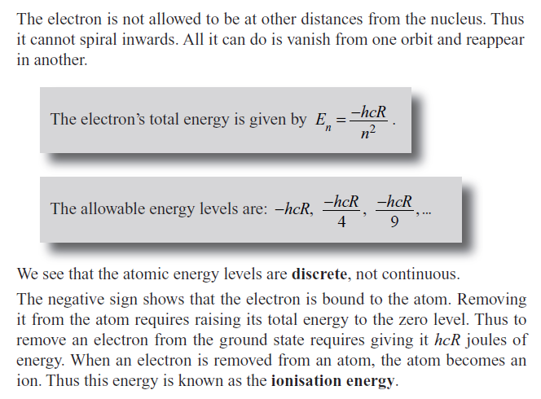

Slide 36
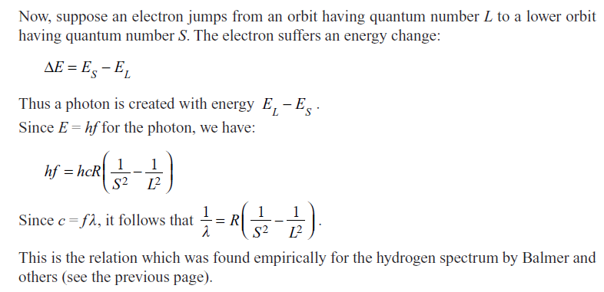
Balmer
Empirical
equation

